Slide 1


IMDB Movies
Final Project Data Analysis
Denilson Wilson Aguilar Molina
05/07/2024

Slide 2
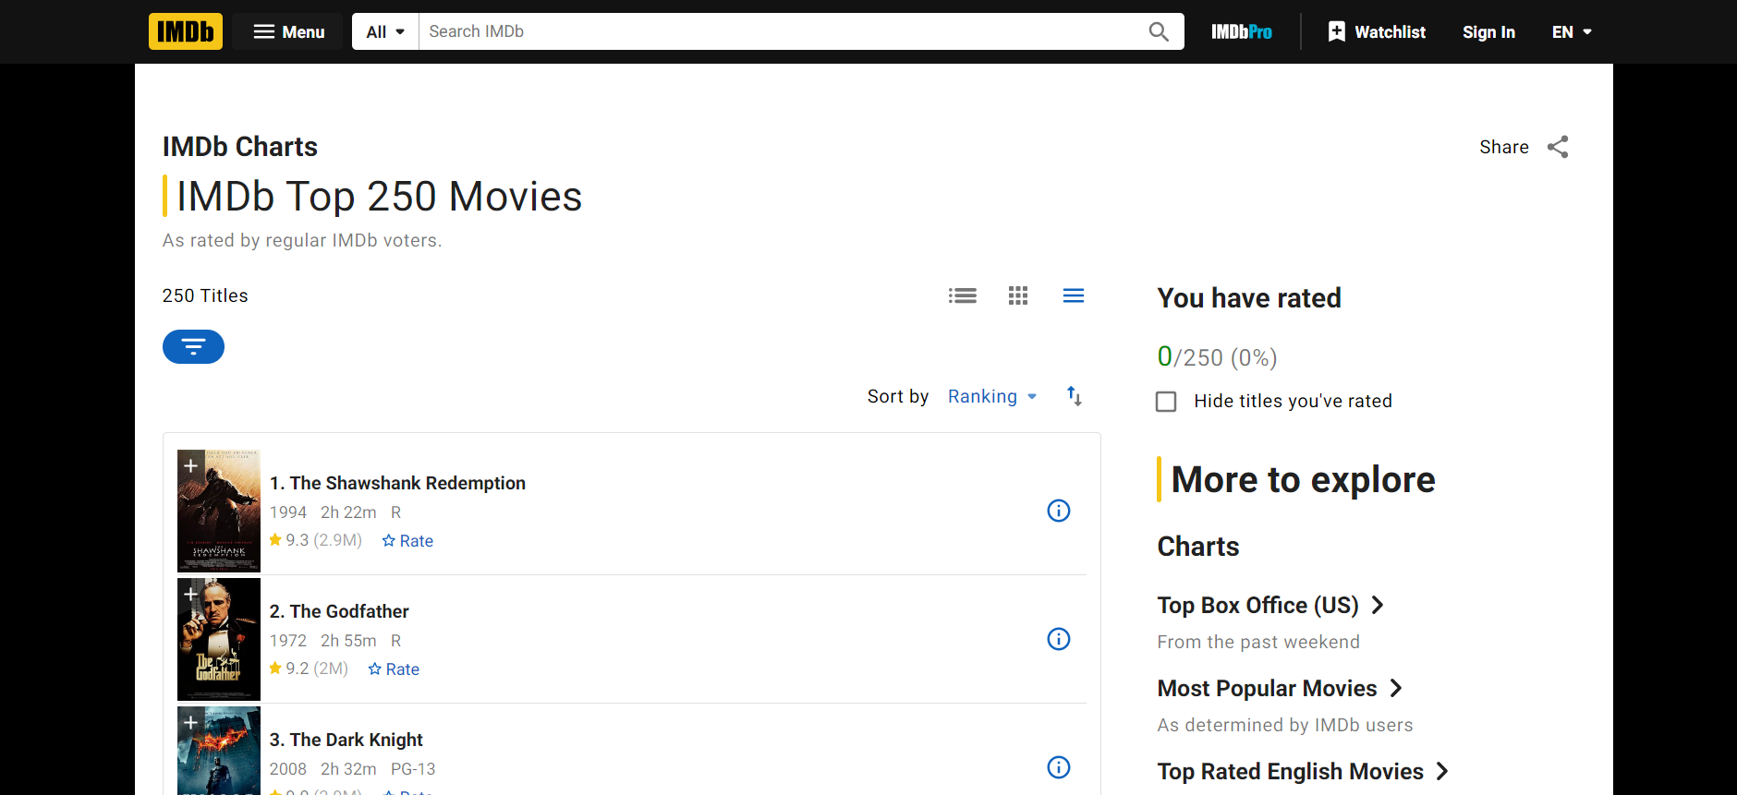
Introduction
Project analyzes IMDb movie data to uncover trends and insight
Helps the film industry understand audience preferences and make informed decisions.
Notes:
Brief Overview of the Project:
This project involves the analysis of IMDb movie data for insights and trends. I examined aspects of movie data, It aims to uncover patterns that can help big companies interested in movie production and profitability to make an informed decision.
Importance of Analyzing Movie Data:
Analyzing the IMDb movies file provides insight into audience preferences, industry trends, and the impact of different factors on the success of movies/films. This analysis can help filmmakers, producers, and studios make informed decisions about content creation, marketing strategies, and resource allocation.
Objectives of the Analysis:
It identifies trends in movie ratings over time to understand how audience preferences have evolved. Explore the correlation between movie runtime and ratings to determine if there is an ideal length for a successful movie. Highlight the top-rated movies from different time periods. Provide an analysis of the impact of film certificates on movie ratings and gross revenue to understand the influence of content ratings on audience reception.

Slide 3





Tools
Jupyter Notebook, Python
Python packages: pandas, matplotlib, and seaborn
Notes:
For this project, I used Python with pandas, matplotlib, and seaborn for data analysis and visualization. Jupyter Notebook was used for code execution and documentation.

Slide 4

Questions Asked
What are the top 10 highest-rated old movies (before 1950)?
What are the top 10 highest-rated recent movies (after 2000)?
Do movies in certain genres tend to receive higher ratings?
Are there any trends in movie ratings based on the year of release?
What is the correlation between runtime and ratings?
Who are the top 10 directors with the highest average ratings for their movies?
What is the distribution of ratings among different film certificates, and is there a noticeable difference in ratings between different certificates?
Notes:
Top-rated movies from different eras
Influence of genres on ratings
Trends in movie ratings over time
Correlation between runtime and ratings
Impact of film certificates on ratings
Directors with the highest average ratings
Distribution of ratings among film certificates

Slide 5

Data Overview
The dataset holds information of 1000s movies, and includes 18 attributes.
Allows for a lot of data exploration
Notes:
The IMDb movie dataset contains information about 1000 movies, it has attributes such as movie title, genre, runtime, release year, rating, and certificate. The dataset provides me with a comprehensive view of the movie data, I could use this information for analyzing the dataset.

Slide 6
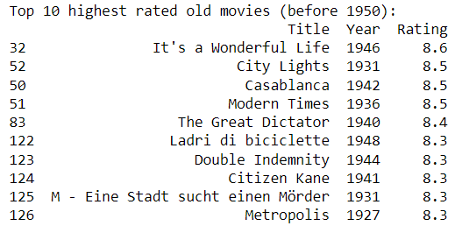
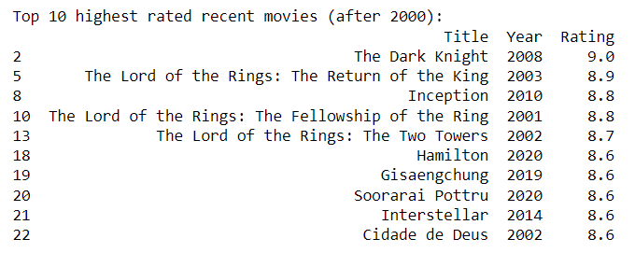
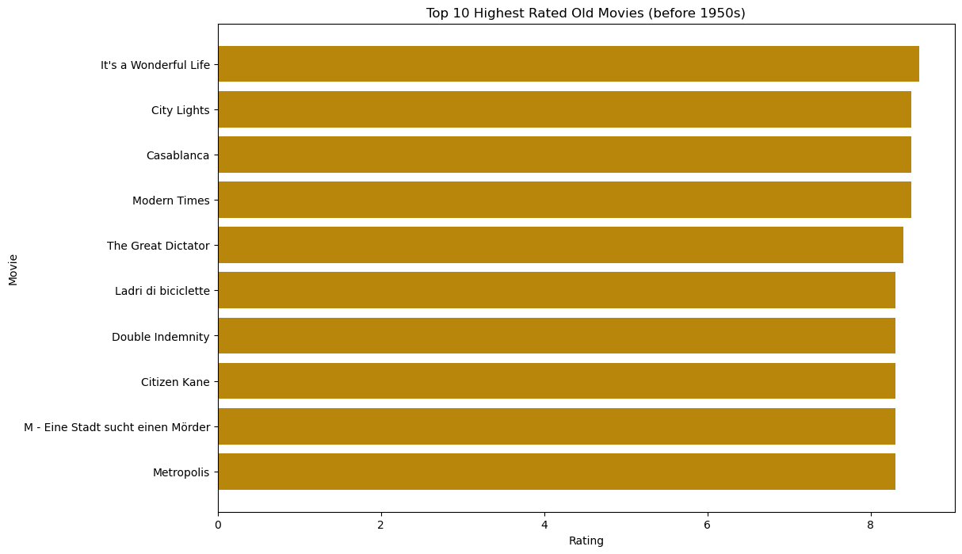
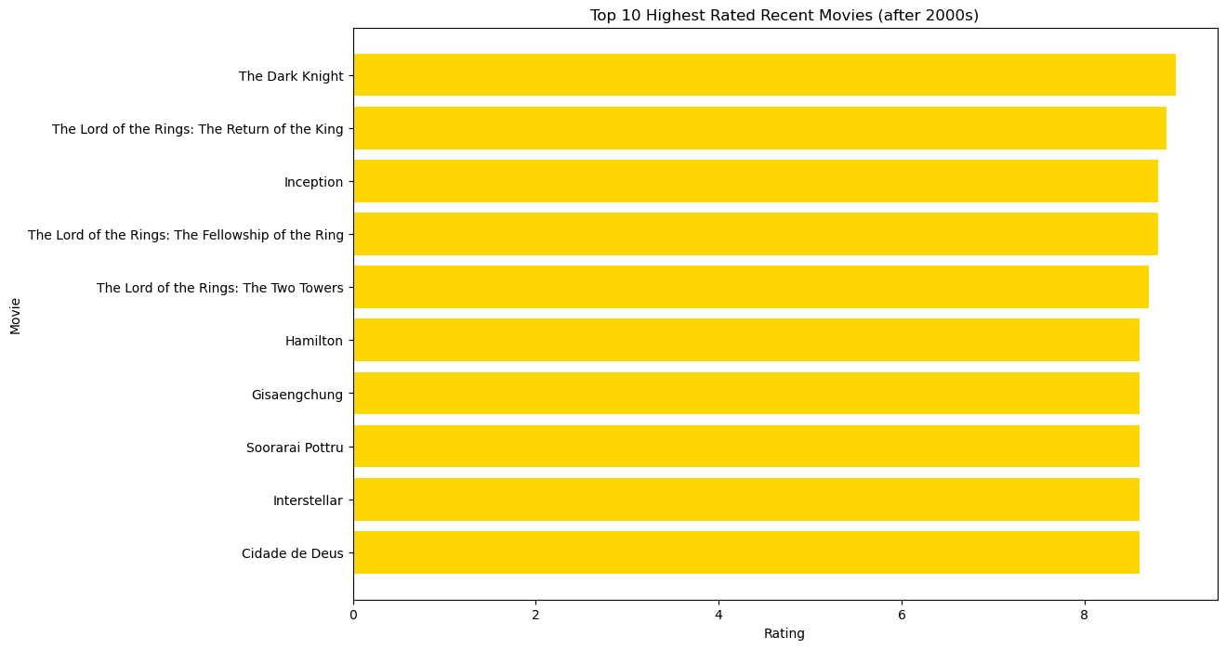
Top 10 Highest Rated Movies
What are the top 10 highest-rated old movies (before 1950)?
What are the top 10 highest-rated recent movies (after 2000)?
Helps the film industry understand audience preferences in old and recent movies
The release year of the movie doesn’t change how its rated by people
Notes:
Placed them together because they are more connected, planned as a 2 parter.
The Top 10 Highest Rated Old Movies (Before 1950):
These movies showcase timeless classics that have endured through the years, indicating exceptional storytelling and cinematic quality.
The high ratings suggest that these older movies have left a a big and lasting impact on audiences and the critics.
Top 10 Highest Rated Recent Movies (After 2000):
These movies represent recent cinematic achievements that have garnered praise for their storytelling, direction, and performances. It also shows that even movies today can get higher ratings then the old classic movies
The high ratings indicate that these movies have resonated with modern audiences.
The top-rated old movies (before 1950) and recent movies (after 2000) demonstrate that the age and time period of a movie does not necessarily dictate its quality or audience reception.
Both sets of movies have received high ratings, indicating that exceptional filmmaking transcends time, and appeals to audiences across generations.

Slide 7
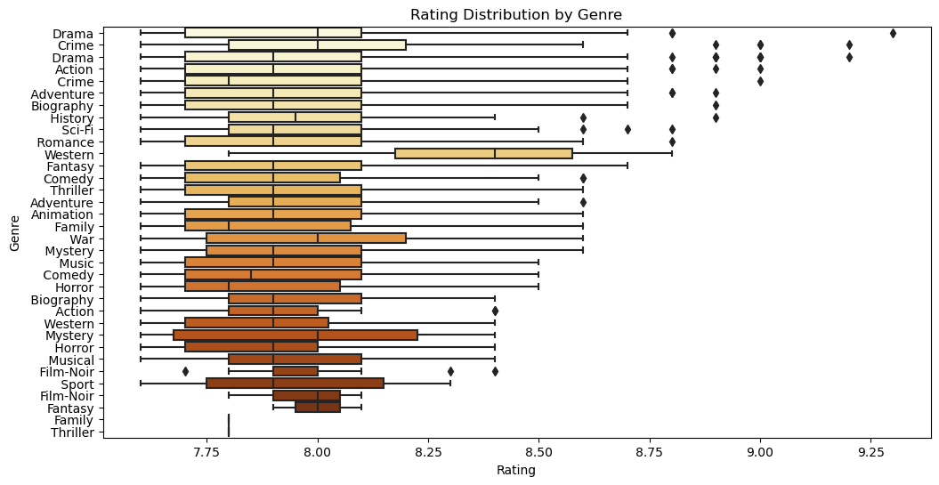
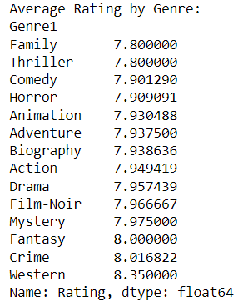
Analysis of Movie Ratings by Genre
3.Do movies in certain genres tend to receive higher ratings?
Helps the film industry understand how moving ratings changed.
Top 3 are Western, Crime, and Fantasy
Notes:
Movies in certain genres Do tend to receive higher ratings than others, based on the average ratings calculated for each genre.
Western genre movies have the highest average rating, followed by Crime, Fantasy, and Mystery genres.
This ranking suggests that Westerns, Crime, Fantasy, and Mystery films connected more strongly with audiences, leading to their higher ratings.
The plot shows a clear trend where certain genres consistently receiving higher ratings, which reflects the preferences and tastes of movie watchers.

Slide 8
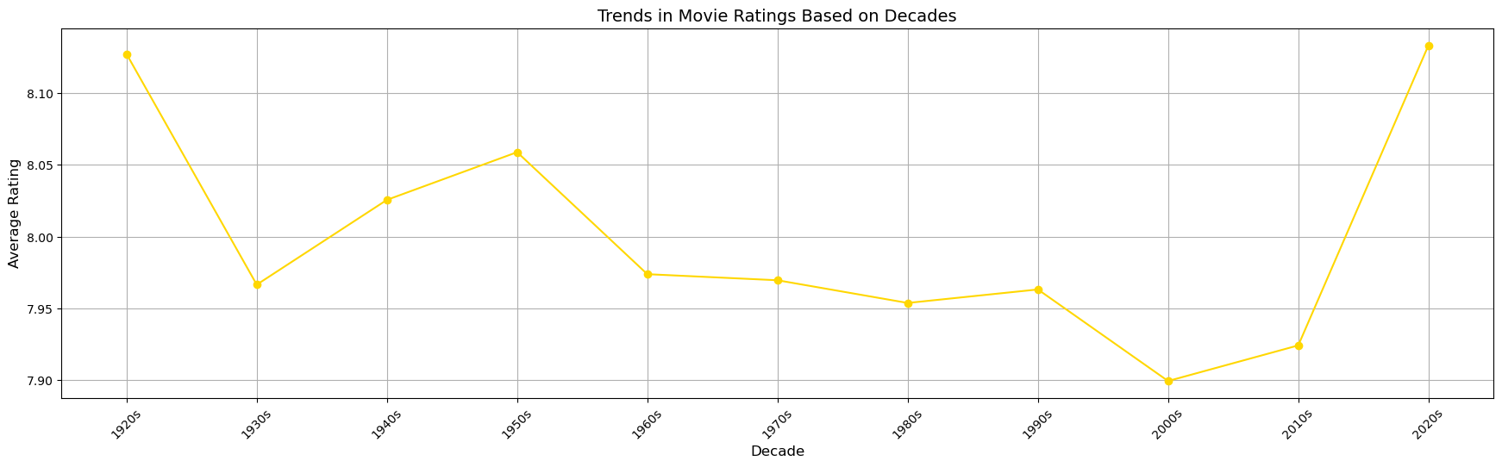
Trends in Movie Ratings Based on Decades
4. Are there any trends in movie ratings based on the year of release?
Helps the film industry understand change in average ratings over decades
Started high and slowly reached its peak recently, after big drop
Notes:
The average movie rating showed significant fluctuation over the decades, indicating changing audience preferences and film industry trends.
In the 1920s, the average rating was around 8.13, dropping slightly to approximately 7.96 in the 1930s, then increasing to 8.03 in the 1940s, and peaking at around 8.06 in the 1950s.
However, there was a decline in the average rating in the subsequent decades, reaching its lowest point at 7.90 in the 2000s.
The trend shifted upwards again in the 2010s, with the average rating increasing to 7.93, and a significant increase occurring in the 2020s, where the average rating rapidly reached its peak at 9.14.
These trends suggest that movie ratings have fluctuated over the years, influenced by factors such as changes in filmmaking styles, audience preferences, and critical reception.

Slide 9
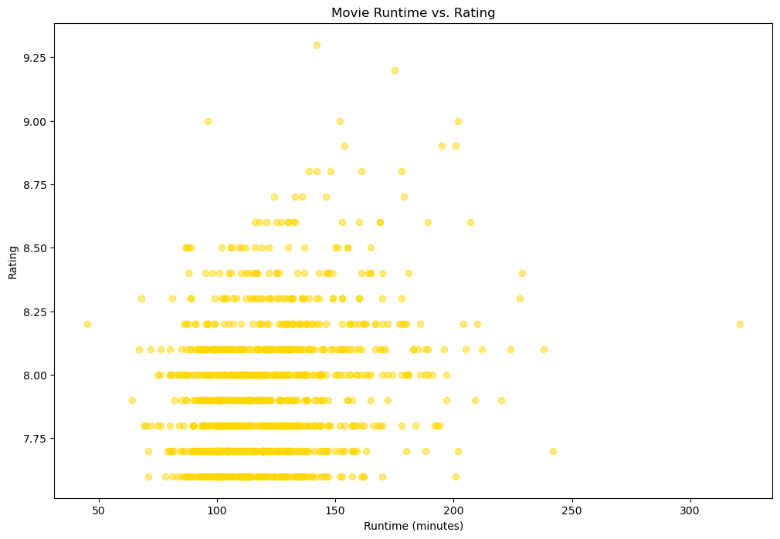
Movie Runtime vs Ratings
5. What is the correlation between runtime and ratings?
Helps the film industry understand how runtime and ratings interact with each other
Weak positive correlation between runtime and ratings
Some exceptions but on average between 150 and 200 higher ratings
Notes:
The correlation coefficient between movie runtime and ratings is approximately 0.2431, indicating a weak positive correlation between the two variables.
This means that there is a tendency for movies with longer runtimes to have slightly higher ratings, but the relationship is not very strong.
There are exceptions, as some movies with shorter runtimes can also have high ratings.
Movies with runtimes between 150 and 200 minutes tend to have higher ratings on average, with some movies even peaking at a rating of 9.25.
Overall, while there is a slight trend for longer movies to have higher ratings, there are many other factors that can influence a movie's rating.

Slide 10
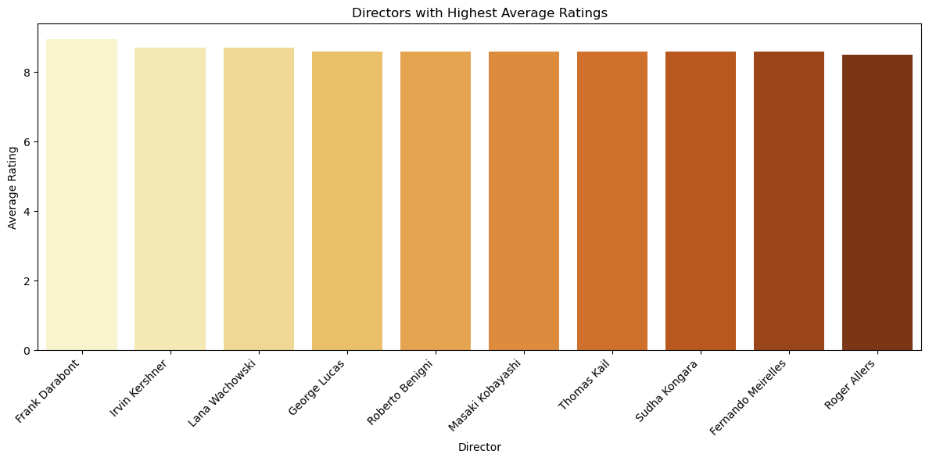
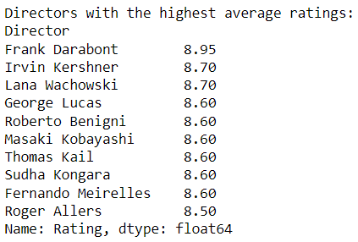
Directors with Highest Average Ratings
6. Who are the top 10 directors with the highest average ratings for their movies?
Helps the film industry understand how a director may affect movie ratings
Top 3 from this top 10 are Frank, Irvin, and Lana
Notes:
Frank Darabont leads the list with the highest average rating of 8.95, indicating a strong positive reception to his work.
Irvin Kershner and Lana Wachowski follow closely, both with an average rating of 8.70, showcasing their ability to consistently deliver high-quality films.
George Lucas, Roberto Benigni, Masaki Kobayashi, Thomas Kail, Sudha Kongara, and Fernando Meirelles all have an average rating of 8.60, demonstrating a remarkable level of consistency in producing well-received movies.
This analysis provides valuable insights into the directors who have been most successful in terms of audience appreciation, highlighting their talent and impact on the film industry.

Slide 11
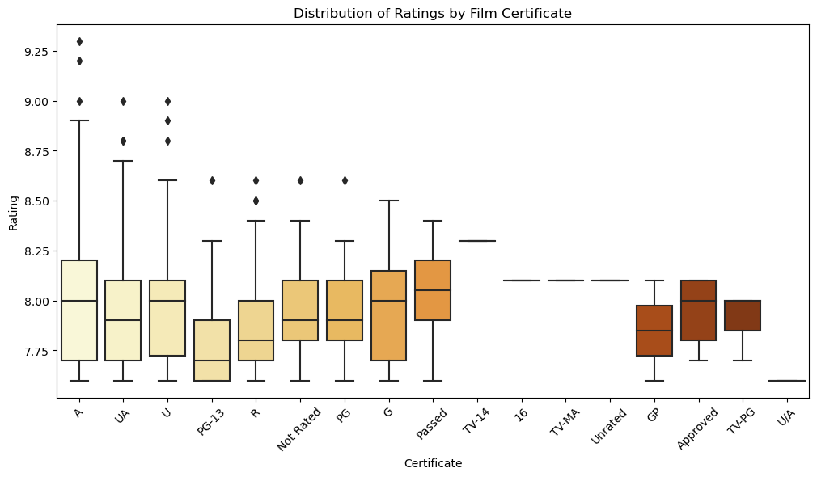
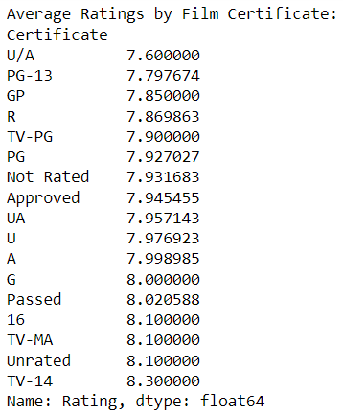
Distribution of Ratings by Film Certificate
7. What is the distribution of ratings among different film certificates, and is there a noticeable difference in ratings between different certificates?
Helps the film industry understand how a ratings and certificates affect movies.
Films rated G, A have highest average ratings at 8.0 followed by TV-14, etc.
Notes:
The ratings are evenly distributed across different certificates, indicating that there isn't a significant difference in the overall quality of films based on their certificate.
Films rated 'G' and 'A' have the highest average ratings, both at 8.0, followed closely by 'TV-14', 'Unrated', and '16' certificates, all with an average rating of 8.1. This suggests that these certificates may generally be associated with higher-quality films.
Certificates like 'U/A', 'PG-13', 'GP', and 'R' have respectable average ratings, ranging from 7.6 to 7.9, indicating that films under these certificates are well received.
The 'TV-MA' certificate, typically associated with mature content, has a relatively high average rating of 8.1, suggesting that these films are still of high quality despite their content.
This analysis provides insights into the quality of films across different certificates, highlighting the diverse range of films that receive high ratings from audiences and critics alike.

Slide 12

Recommendations
Producing movies in Western, Crime, Fantasy, & mystery genre
Pay attention to trends, film which aligns with current trend
Runtime doesn’t matter as much, don’t make it too long though
Collaborate with experience directors
Films under G, A, TV-14, and Unrated have high ratings
Notes:
Consider producing movies in genres like Western, Crime, Fantasy, and Mystery, as they have shown a tendency to receive higher ratings.
Pay attention to changing trends over the decades and adapt storytelling and production styles to align with current audience preferences.
While longer movies tend to receive slightly higher ratings, focus on creating engaging content regardless of runtime to ensure audience satisfaction.
Collaborate with experienced directors with a track record of delivering high-quality films to enhance the chances of success.
Explore the potential of producing films under 'G', 'A', 'TV-14', 'Unrated', and '16' certificates, as they are associated with higher average ratings and possibly greater audience acceptance.
These recommendations are based on the analysis of IMDb movie data and can provide valuable insights for filmmakers and producers looking to enhance the quality and reception of their films.

Slide 13
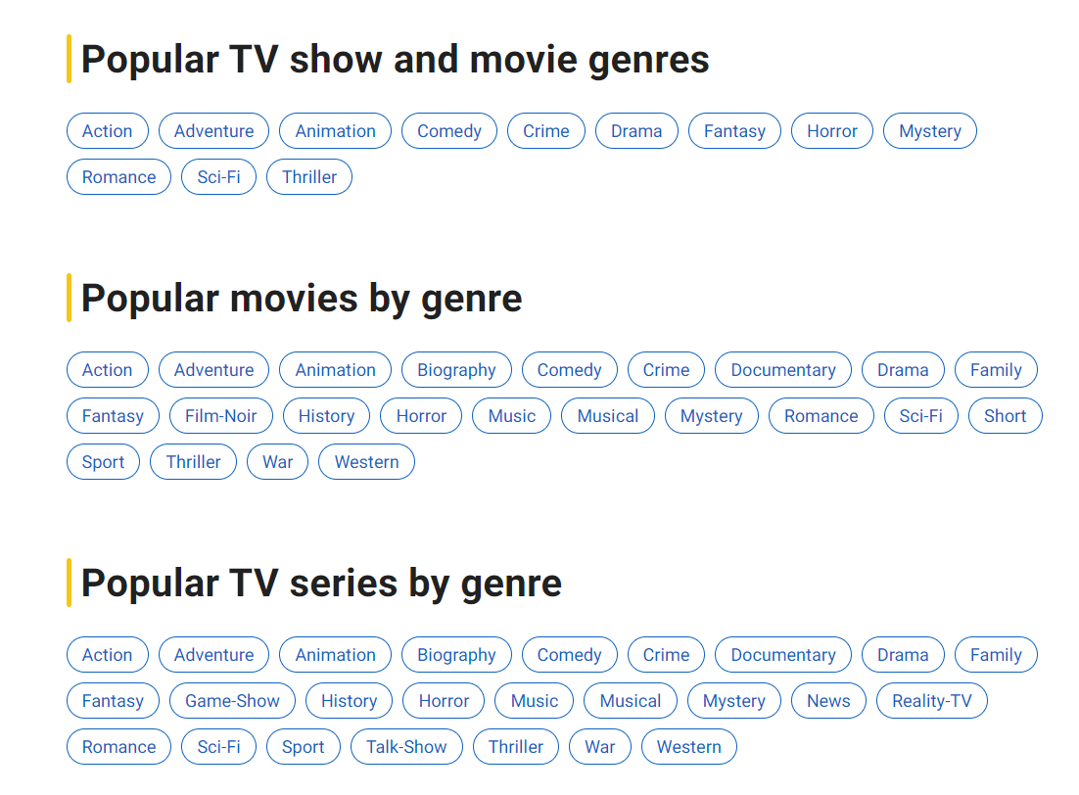
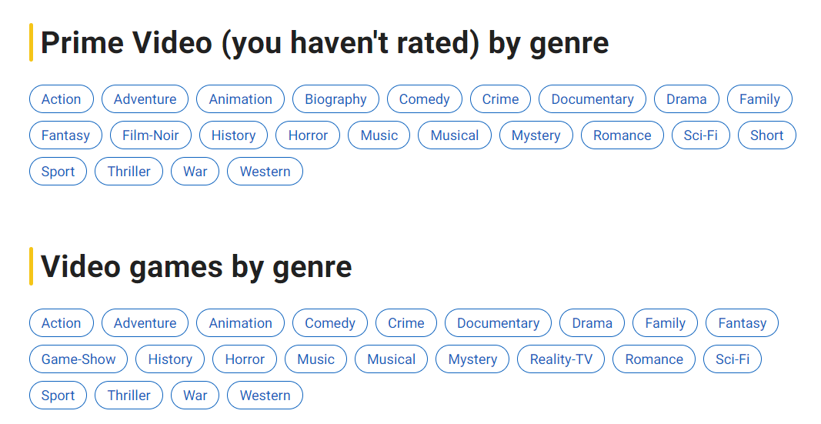
Future Work
Exploring relation of gross and ratings
Exploring relation of runtime and year
Exploring star impact on ratings
Exploring relationship of certificate and runtime
Notes:
I want to analyze the relationship between movie gross and ratings since it can provide insight to determine if the ratings also influence its gross worth.
I want to Investigate the relationship between runtime and year to determine if movies in recent times are longer on average in comparison to recent movies.
I want to Investigate the impact of actors/actresses (star1, star2, star3) on ratings, it can give me insight on how they impact the success of a movie.
I want to investigate the relationship between certificate and runtime more to determine if certain certificate movies tend to run longer or less compared to others.

Slide 14
Sources
1.https://www.imdb.com/?ref_=nv_home (for screenshots of IMDB)
2.https://www.kaggle.com/datasets/harshitshankhdhar/imdb-dataset-of-top-1000-movies-and-tv-shows (for Dataset)
3. https://en.wikipedia.org/wiki/Main_Page (For logo images)
Notes:
I’m so tired, I worked endlessly on this assignment, this took flipping hours to create and work, get done this was so stressful too since it really was coming down to the last few hours

